Slide 1
CCPI
Curriculum Workshop
Council for Curricular Programs and Instruction (CCPI)
September 19, 2019– 3:30 p.m.
Horrabin Hall 1
Contact: Steve Bennett, CCPI Chair 2019-2020
Email: SW-Bennett1@wiu.edu
Office Phone: 309-298-1256
Office: Tillman Hall 109

Slide 2
What is CCPI?
Council on Curricular Programs and Instruction
Faculty Senate subcommittee
Members serve for 3 years
Makes curriculum recommendations to Faculty Senate
Deals only with UNDERGRADUATE curriculum
Who is CCPI?
Members, 2019-2020:
Steve Bennett, EAGIS (Chair)(A&S)
Barry Birnbaum, Education (E&HS)
Eun Go, Broadcasting & Journalism (Secretary)(FA&C)
Leaunda Hemphill, Engineering Technology (B&T)
Ryan Homer, SGA Representative
Bob Intrieri, Psychology (Vice Chair)(A&S)
Hadley Kaminga-Peck, Theatre & Dance (FA&C)
Jessica Lin, Economics and Decision Sciences (B&T)
Elgin Mannion, Sociology & Anthropology (At-large)
Sebastian Szyjka, Education (E&HS)
TBD (E&HS)
Mark Mossman, Provost's Office (ex-officio)
Donna Williams, Registrar's Office (ex-officio)
Other Attendees:
Annette Hamm, Faculty Senate Office Manager
Linda Prosise, Admin Asst to the Provost

Slide 3
Curricular Process
Departmental Committee
College Committee(s)
CCPI (CGE, CIE, WID, NOT GRADUATE)
Faculty Senate
Provost (IBHE)

Slide 4
What does CCPI see?
New proposals and changes to existing curriculum
Supporting documentation could include:
  Letters of approvals from other departments
  Feasibility Studies are now required to be submitted with the appropriate curricular requests
Do not need syllabus
  If you refer to it in the form, it will be asked about
Provost → Curriculum Approval: has more information on this process

Slide 5
Those Pesky Terms
Degree (T/F)
Comprehensive Major (T/F): No Minor needed
Non-comprehensive Major (T/F): Minor
Minor (T)
Concentration (T/F)
  Interdisciplinary Studies
Emphasis (not transcripted and no feasibility study)
Option (T/F)
Track (no approval needed)
Certificate of Undergraduate Studies (T/F)
T = Transcripted
F = Feasibility Study

Slide 6
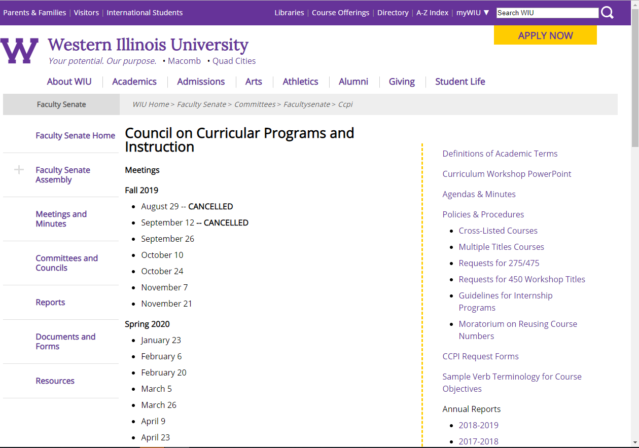
CCPI’s Website
http://www.wiu.edu/faculty_senate/committees/facultysenate/ccpi/

Slide 7
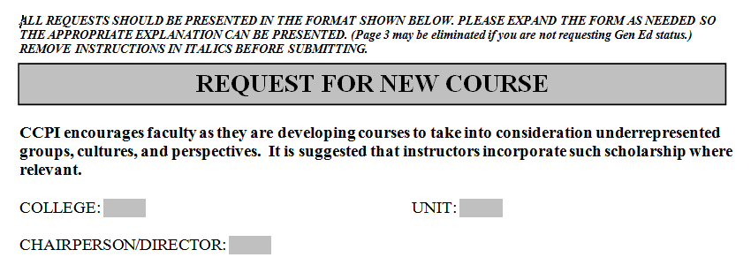
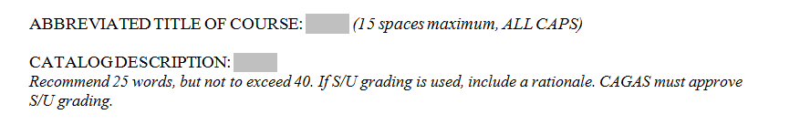
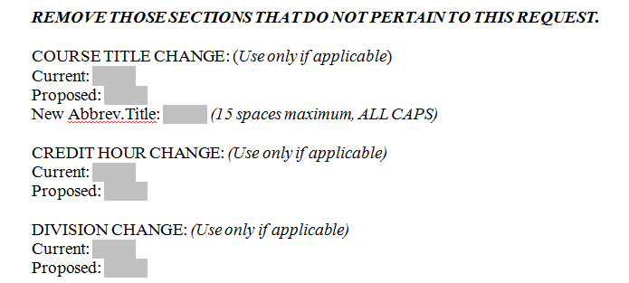
Tips for All Forms
Put reason for request in the gray box
Remove directions in italics
Remove sections that are not relevant to your proposal
Count words and letters! (We will)
Make sure your old information matches the current catalog
No Gs!
Check with ALL other departments
Search the catalog
  Course titles, descriptions, and content

Slide 8
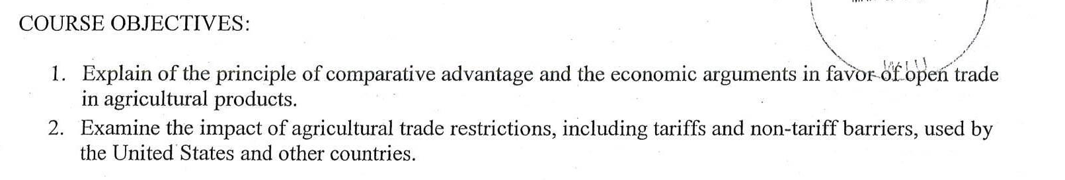
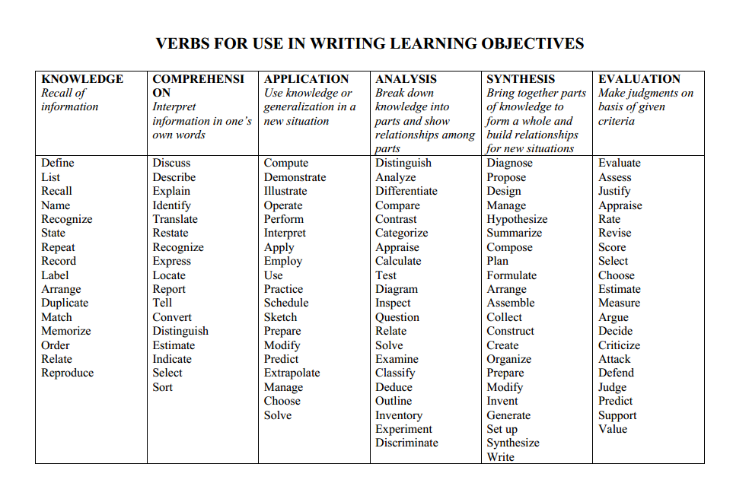
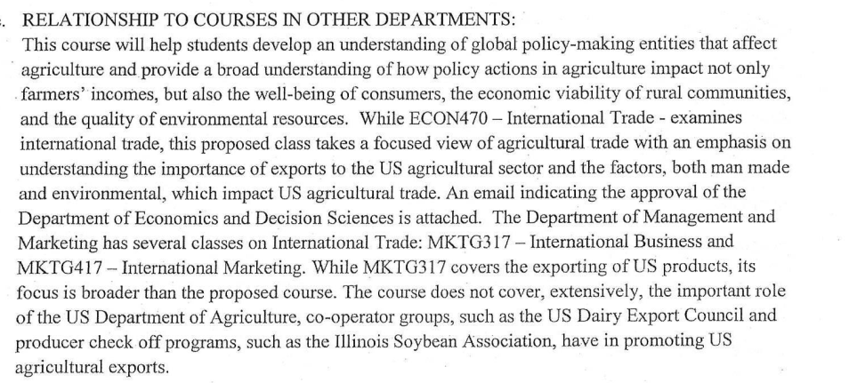
Request for New Course
Goes to Faculty Senate and Provost’s Office after CCPI
Prerequisites
Course objectives (action verbs)
Letters of support
Moratorium on number reuse

Slide 9
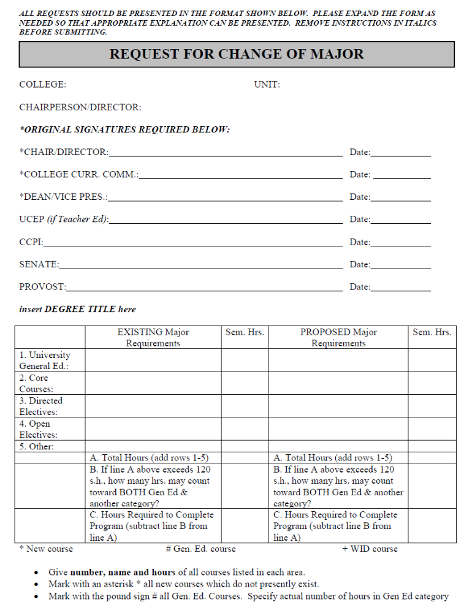
Request for Change of Major or Minor
Goes to Faculty Senate and Provost’s Office after CCPI
Your curriculum is a living thing. Keep track of how it changes!
Keep organization consistent with the current catalog as much as possible.

Slide 10
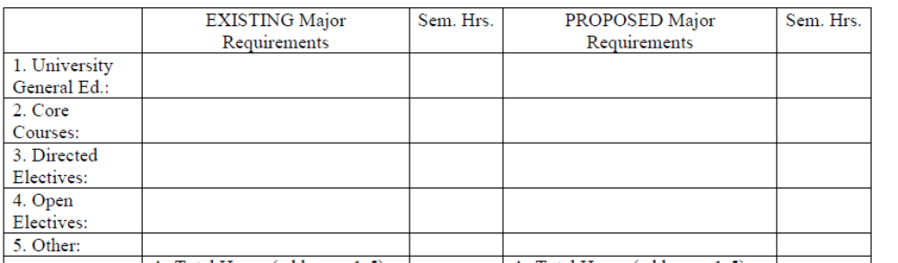
Request for Change of Major or Minor
Goes to Faculty Senate and Provost’s Office after CCPI
Line up changes
Use SAME if no change from “EXISTING”
Bold changes
If you need help, ask!
Line up changes in these columns
use SAME if no change

Slide 11
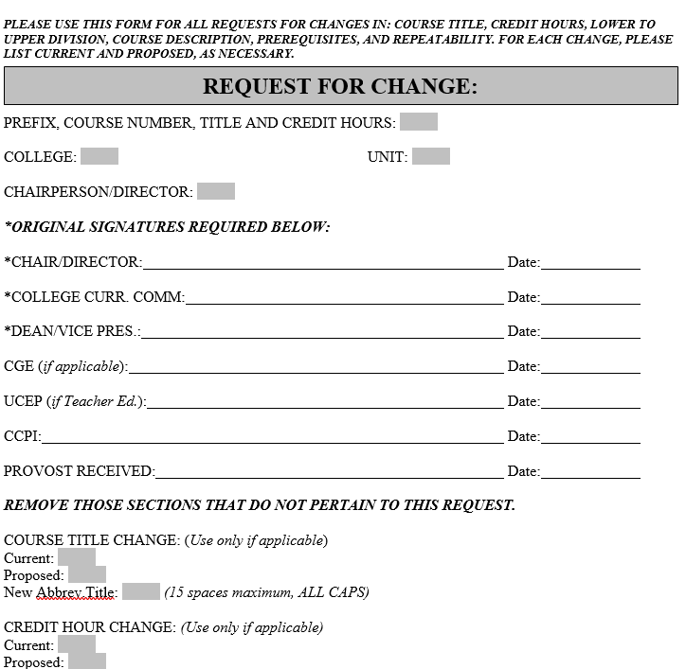
Multipurpose Request for Change Form
Goes straight to Provost’s Office after CCPI
Course Title
Credit Hour
Division Change
Course Description
Prerequisite
Repeatability
One request form can include multiple changes

Slide 12
What Doesn’t CCPI Need to Approve?
Changes in course numbers WITH THE EXCEPTION of changes from lower to upper division or from upper to lower division
Changes in course titles
Minor changes in specified course content and objectives, such as:
  Nomenclature
  Changes that do not increase course content or expand objectives
Minor changes in course requirements for a major, minor, option, concentration, emphasis, or certificate of undergraduate studies which do not change the core, specify required general education courses, or result in a net increase in the number of required hours in the program, such as:
  Changing courses included in directed electives (including adding)
Changes in course prerequisites (not new or increased), such as:
  Deletion of a prerequisite
  Permission statements (e.g., permission of instructor required)
  Change in prerequisite that stays within the same department/school/unit, upper or lower division, and semester hour range
Dropping of courses no longer needed
Changes in course prefixes
Send all of these to Provost’s Office.

Slide 13
CCPI Meetings 2019-2020
September 26
October 10
October 24
November 7
November 21
January 23
February 6
February 20
March 5
March 26
April 9
April 23
Curricular requests should be submitted to the Faculty Senate Office one week prior to each meeting.
Dates should be somewhat comparable for 2020-2021
All CCPI meetings are at 3:30 p.m. on Thursdays in Horrabin Hall 1

Slide 14
Get Help Early
Contact Information
Steve Bennett, CCPI Chair
  SW-Bennett1@wiu.edu
Linda Prosise, Provost’s Office
  LK-Prosise@wiu.edu
Annette Hamm, Faculty Senate Office
  AE-Hamm@wiu.edu
Donna Williams, Registrar’s Office
  DJ-Williams@wiu.edu
Mark Mossman, Provost’s Office
  MA-Mossman@wiu.edu
Remember, this process is here to help you develop curriculum, not stand in your way!

