Slide 1
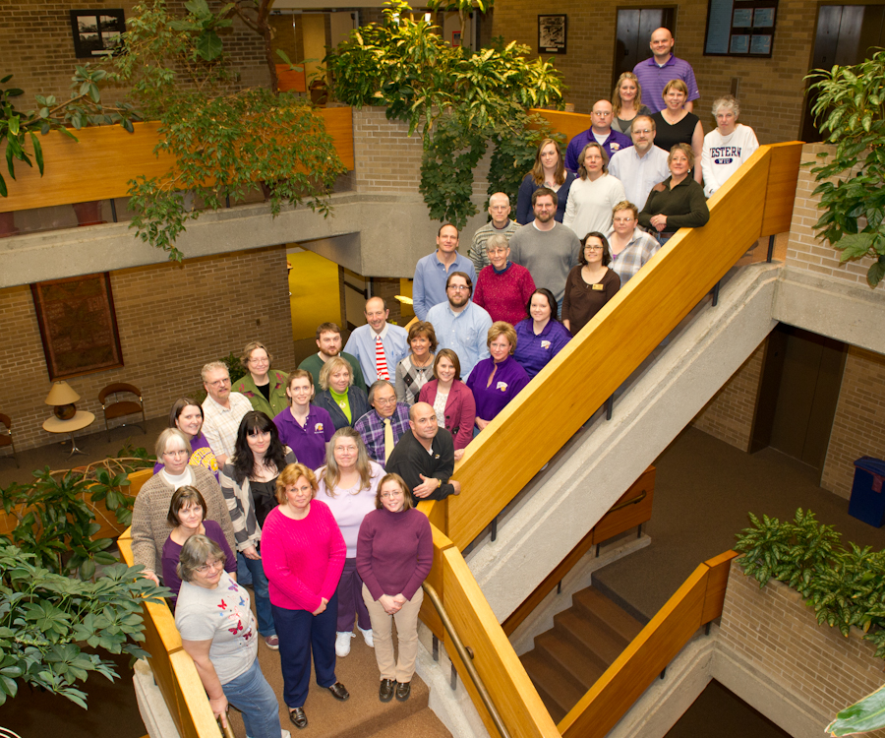
University Libraries
Consolidated Annual Report, Planning Document and Budget Request

Slide 2
University Libraries
FY12 Budget
Personnel Services 3,353,259
Library Materials 1,516,200
(reduced by $55,000 in FY11)
Development 50,004
Libraries – Operating 204,300
Development – Operating 15,000
Total 5,138,763

Slide 3
Library Personnel
Administrative 2
(Dean, Associate Dean)
Academic Support Professional 1/3
(Development Officer)
Faculty (as of 3/28/12) 18
(includes 2 vacant positions)
Civil Service 41
(includes 1 vacant position)
Students 59

Slide 4
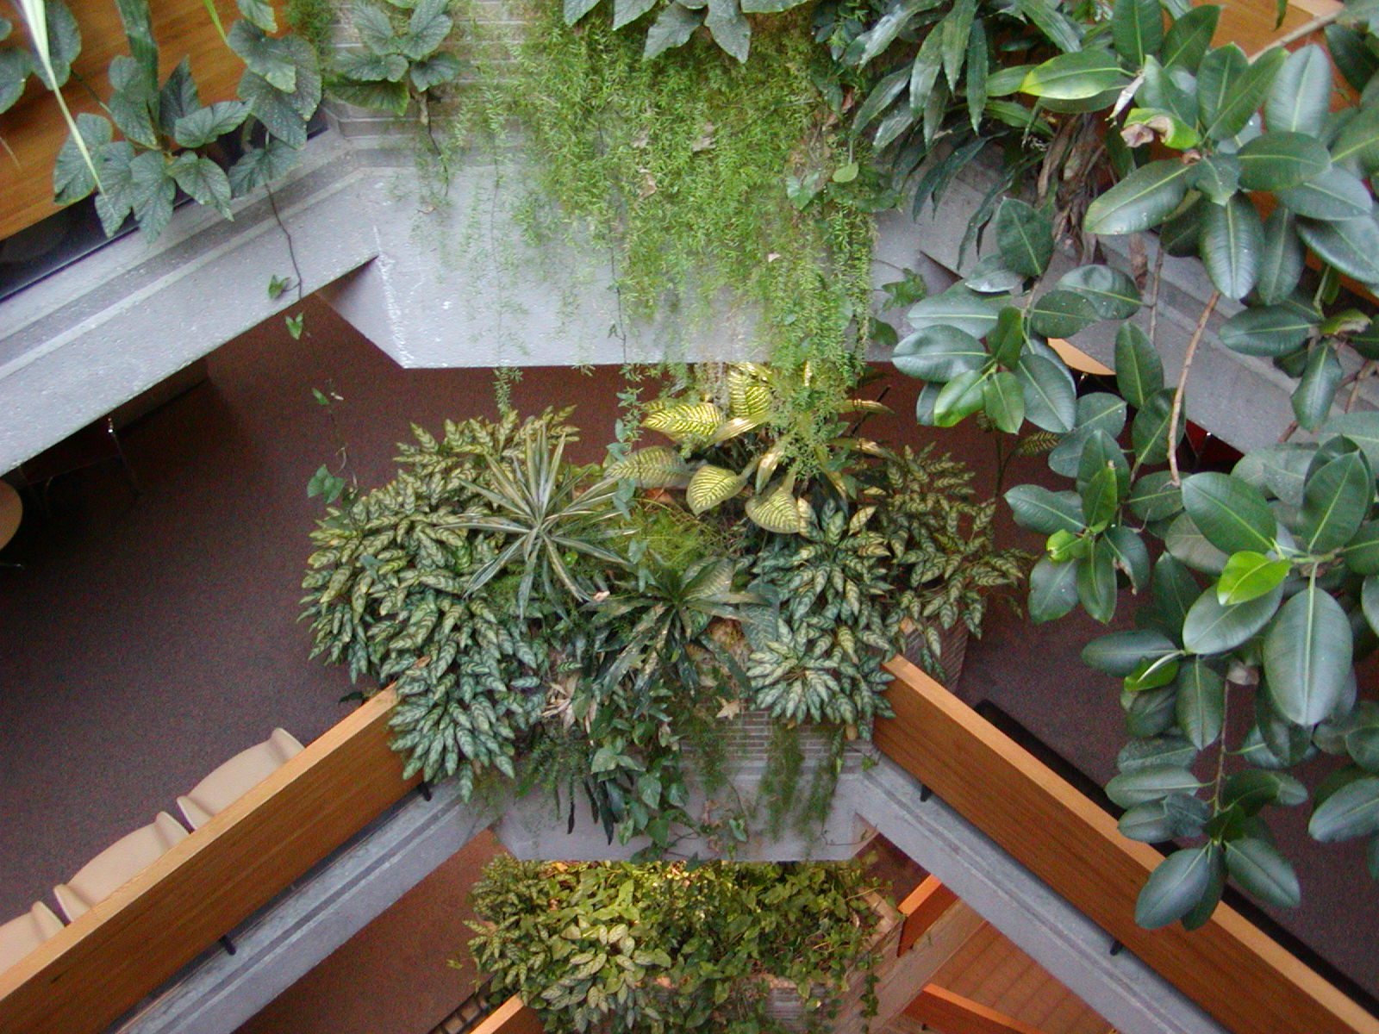
University Libraries
2011 Accomplishments and Productivity

Slide 5

Enhanced Learning Culture
Authors Bibliography and Database
  439 Citations were added
  http://www.wiu.edu/libraries/wiu_authors/index.php
Library Guides
  213 guides were added or updated
    Accessed 54,011 times during 2011

Slide 6
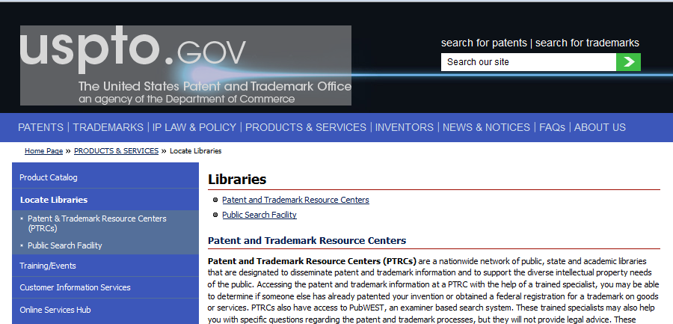

Enhanced Learning Culture
Resource center for:
  U.S. Patent and Trademark Office
  Illinois Legal Aid Online Self-Help

Slide 7
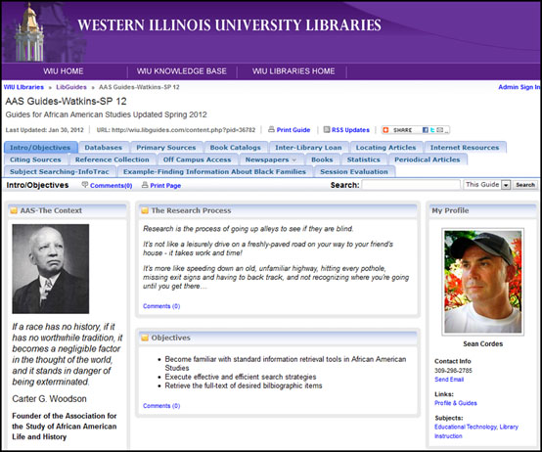

Slide 8
U. S. Patent & Trademark Resource Center
Grand opening will be held in September.
Provides a rich regional resource for small businesses, inventors and entrepreneurs.
Provides the region with a unique body of scientific and technical services.
Shifts focus from the “paper depository” concept to electronic information and specialized training.

Slide 9

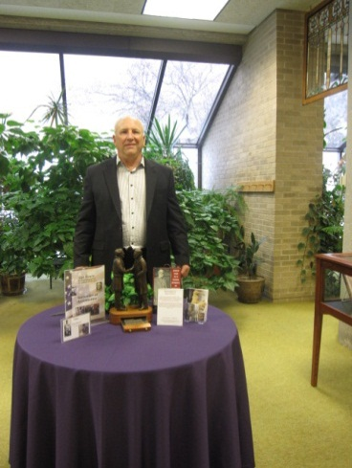
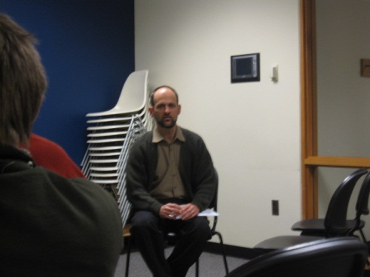
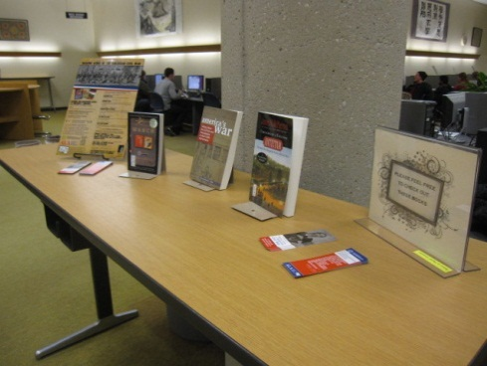
Enhanced Learning Culture
Let’s Talk About It: Making Sense of the Civil War (ALA Grant)

Slide 10



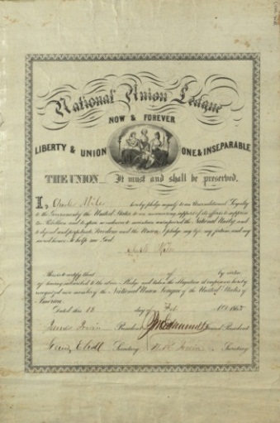
Enhanced Learning Culture
Preservation of Regional History
http://collections.carli.illinois.edu/cdm4/index_wiu_sequel.php?CISOROOT=/wiu_sequel

Slide 11
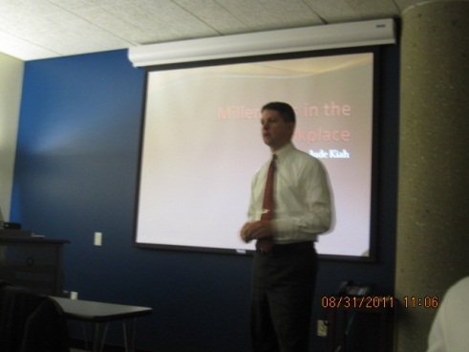
Enhanced Learning Culture
Staff developments and webinars
  Writing Webinar
  Developing 21st Century Skills
  Is Self-Employment Right for You?
  Millenials at Work (or Not)
  Stop Managing Too Much With Too Little
Notes:
CARLI event should be added here. Also, how about the CARLI training staff attend

Slide 12
Enhanced Learning Culture
Prepared for migration to Desire2Learn
Provided mobile reference
Tested Adobe Connect web conferencing
Tested the Application of QR code
Implemented Jing software
Redesigned Libraries’ website

Slide 13
Enhanced Culture for High Achieving Students
Interns from English and Chemistry
Illinois Regional Archives Depository (IRAD) interns in Archives
Graduate Assistants from History, Instructional Design & Technology, Political Science, and RPTA

Slide 14
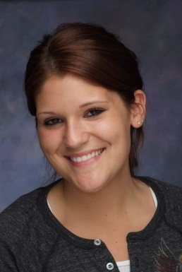
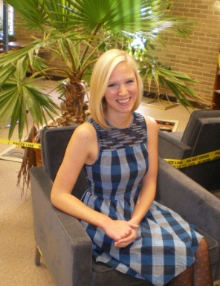
Access and Equity
Graham Scholarships were awarded to the following Libraries’ student employees:
  Sarah Ritter Mercedes Taylor
Established a $1,000 study abroad scholarship to assist students with travel expenses (to implement fall 2012).

Slide 15
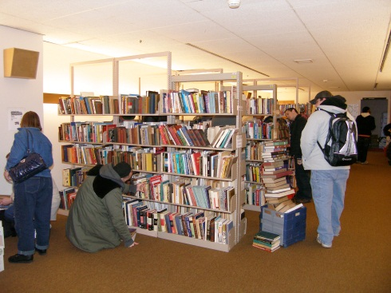
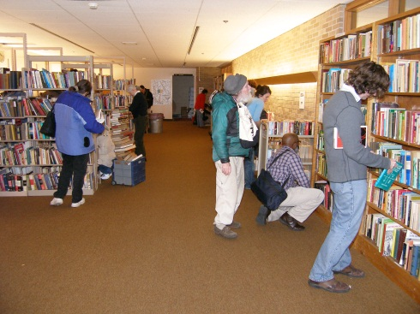
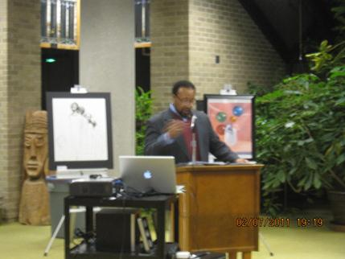
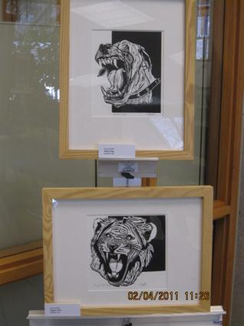
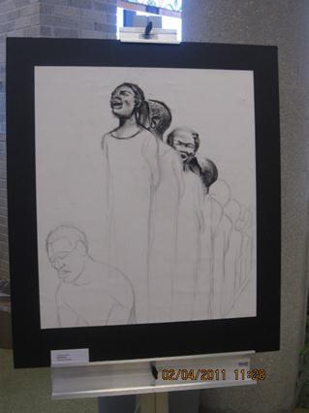
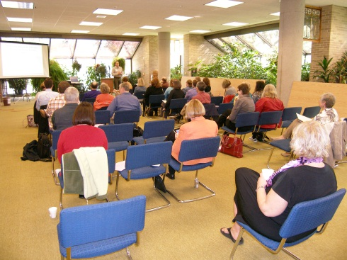
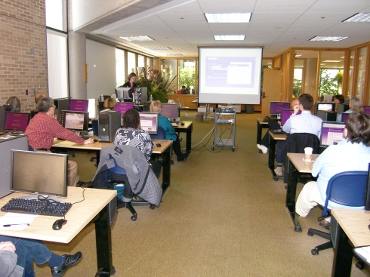
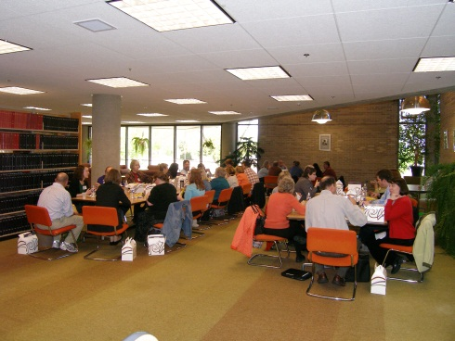
2011 Events
Annual Book & Media Sale
Black History Month – program and exhibit
CARLI visit

Slide 16
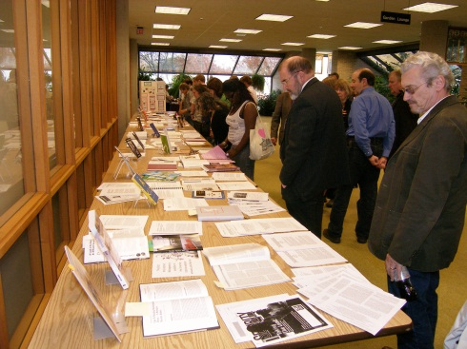
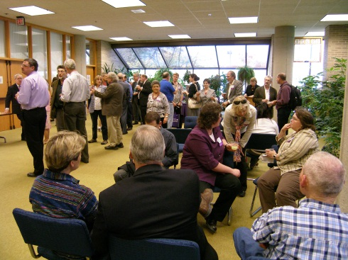
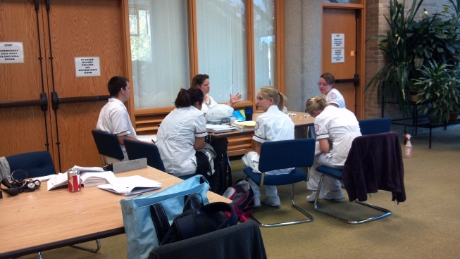
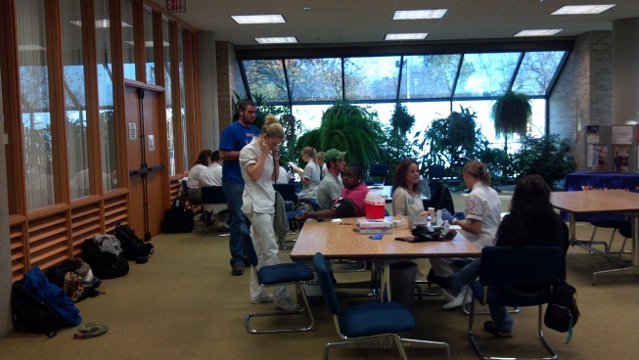
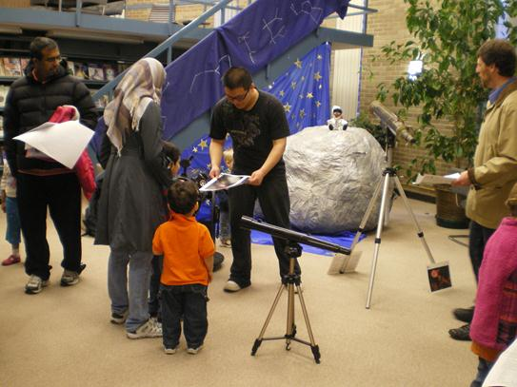
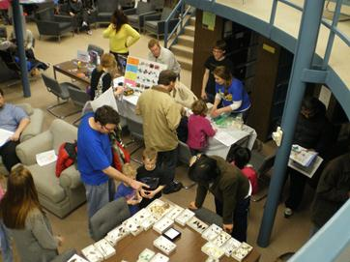
2011 Events
Authors’ Reception
Blood Pressure Screening
by Nursing students
Astronomy Exhibit & Series
Physical Sciences Library

Slide 17
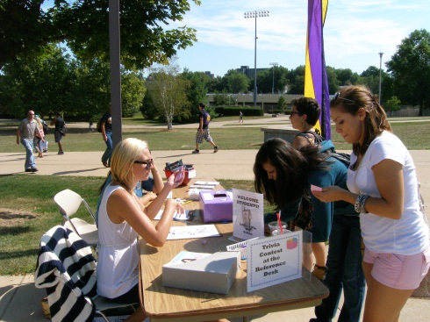
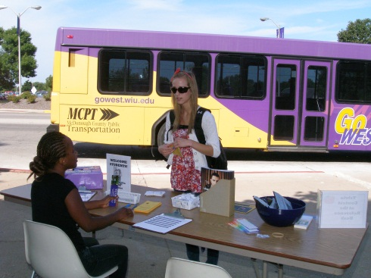
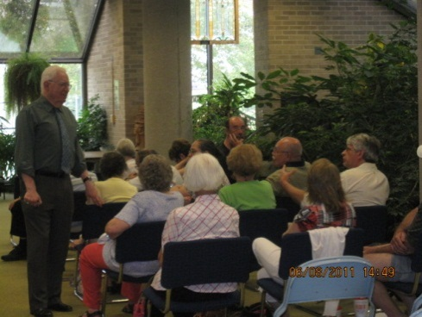
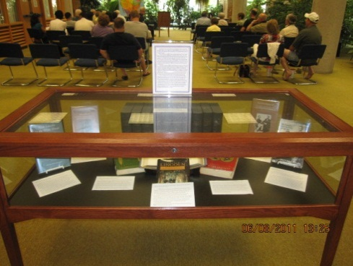
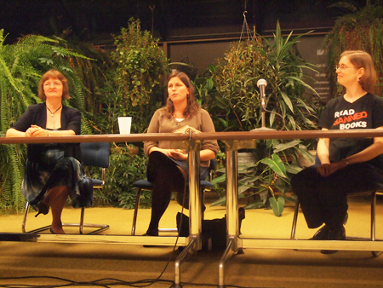
2011 Events
Fall Welcome Tables
Civil War Exhibit & Lecture By Larry Balsamo
Banned Books panel discussion

Slide 18
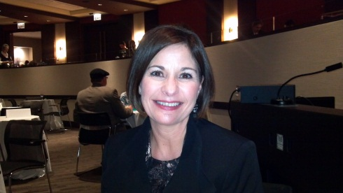
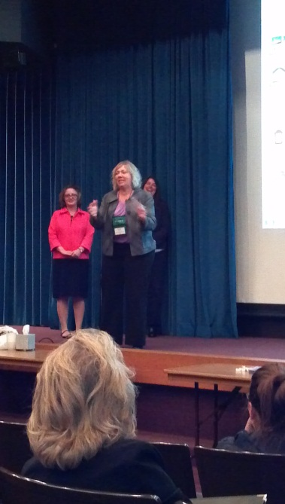
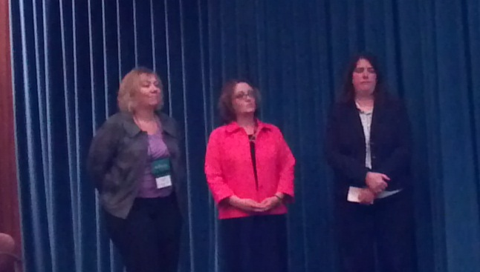
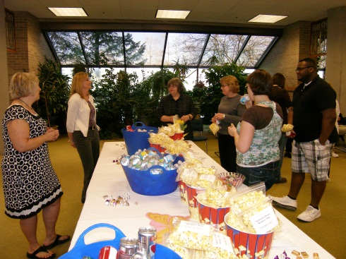
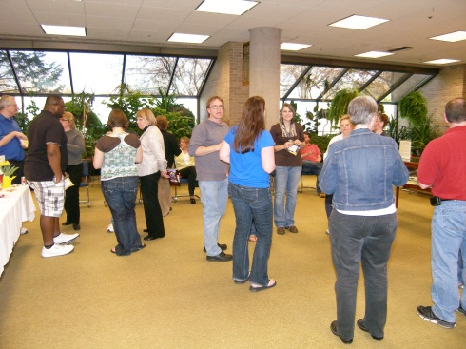
2011 Events
ILA Conference - IL Author, Kathy Barclay
ILeadU presentation
National Library Workers’ Day

Slide 19
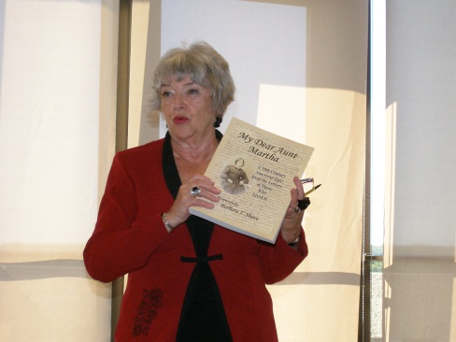
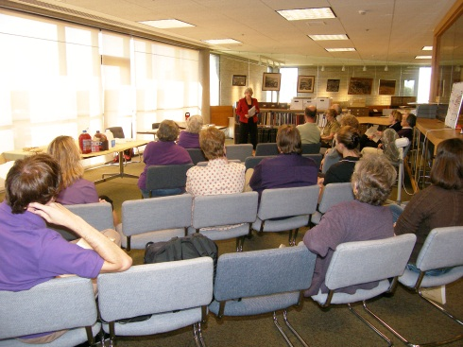
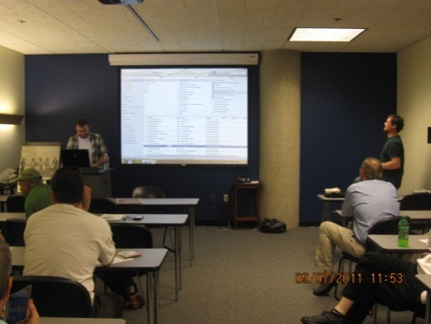
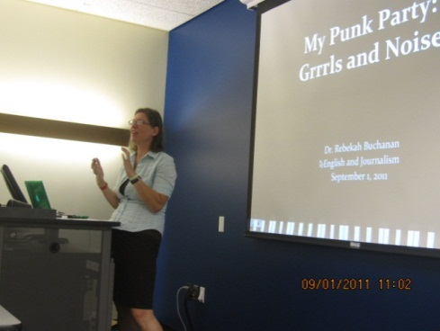
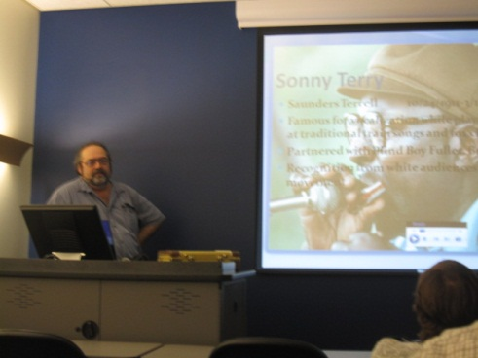
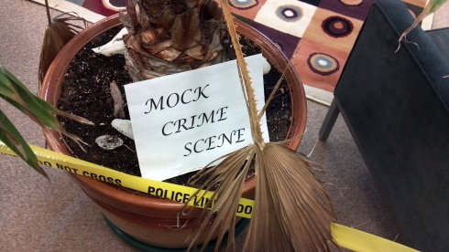
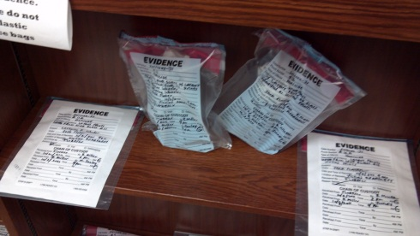
2011 Events
My Dear Aunt Martha
Listening Parties
Forensic Series & Exhibit

Slide 20
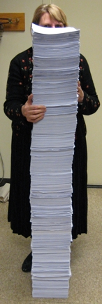
Facilities Enhancement & Deferred Maintenance
Print release station has drastically reduced the paper waste
No paper has been purchased for FY12 (as of 12/31/11)

Slide 21
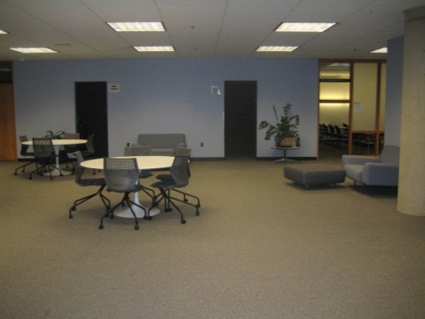
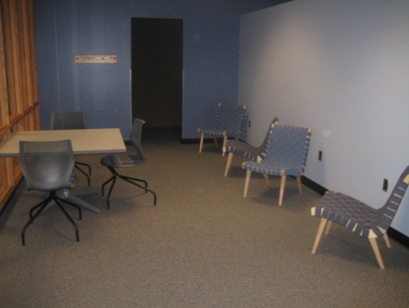
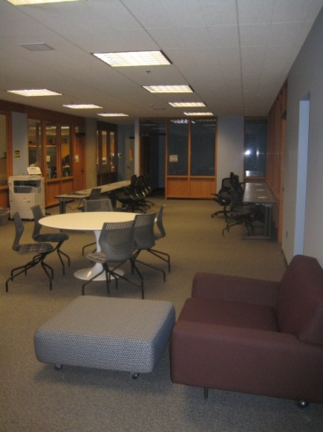
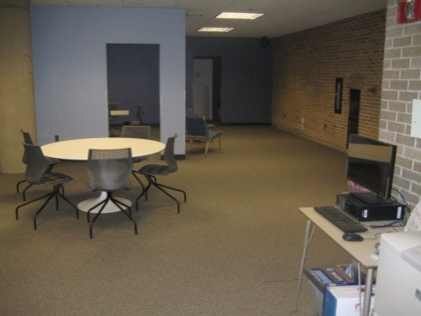
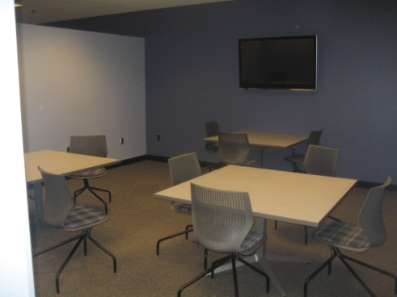
Facilities Enhancement & Deferred Maintenance
Redesign of Digital Commons - a pilot for collaborative learning space and support technology
Grand Opening April 26, 2012

Slide 22
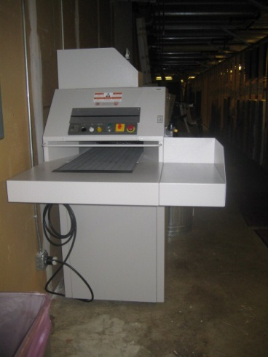
Fiscal Responsibility & Accountability
Responsible for university-wide records management
  Communicate policies and managing workflow with campus offices
  Communicate with State Archives on retention and disposal decisions
  Manage internal/external usage of
  shredder
Notes:
Picture of shredder

Slide 23
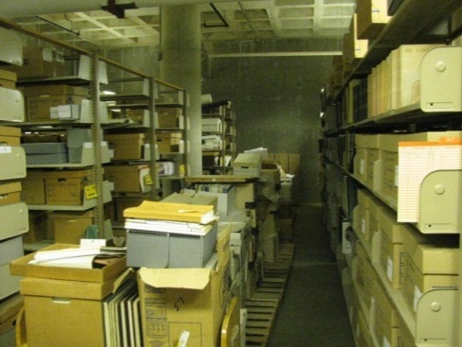



Fiscal Responsibility & Accountability
Reorganized basement storage
After
Before

Slide 24


Fiscal Responsibility & Accountability
Endowment from Elizabeth Kaspar to fund an annual lecture highlighting women in the fields of science, engineering and math
Notes:
Add engineering

Slide 25
Fiscal Responsibility & Accountability
Continue to receive and process gift materials
  for CLEC (Children’s Literature Examination Center)
CLEC item donations are essential to their collection.
We need faculty representation to continue working with CLEC.
Curriculum Library – $3,500 annual budget

Slide 26
Fiscal Responsibility & Accountability
Extensive review of monograph and serial purchases to assess departmental spending and use patterns
  18,360 items were purchased 2006-2011
    68.6% have been circulated at least once
    Average circulation level is at 50%
  In 2011 $475,000 was spent on electronic resources
    Of the 1.3 million searches, 652,000 articles were downloaded – at a cost of 73₵ per download versus a cost of $20/Article at $13,040,000.
Notes:
Need info. From Jeff M.

Slide 28
Fiscal Responsibility & Accountability
Personnel changes:
  2 faculty searches
    Health Sciences Librarian (Unit A)
    Instructional Services Librarian (Unit B)
  4 Civil Service positions audited
    3 upgrades
    1 waiting on results
  2 Civil Service position searches
    Library Specialists – to extend library hours until 2 am
  Felix Chu appointed Interim Associate Dean

Slide 29
Service Function | 2000 | 2010 | 2011 | Percent Increase/Decrease (Between 2010 and 2011)
Circulation | 47,403 | 27,008 | 24.951 | 8% decrease
Reserves (Traditional) | 1,120 | 3,716 | 3,902 | 5% increase
Reserves (courses) | 124 courses | 330 courses | 231 courses | 30% decrease
E-Reserves | 7 courses*** | 92 courses | 75 courses | 18% decrease
Gate Count | 326,777 | 478,892 | 476,709 | .5% decrease
Instructional Programs | 120* | 290 | 280 | 3% decrease
Interlibrary Loan Borrowed | 11,319 | 15,265 | 15,552 | 2% increase
Interlibrary Loan Lending | 17,602 | 16,611 | 16,226 | 2% decrease
Electronic Journal Access | Approx. 300 | 65,149 | 46,353 | 29% decrease
Reference Questions* | 10,914** | 7,277 | 6,493 | 11% decrease
Web Stats Pages viewed | 2,138,156* | 4,708,908 | 3,869,566 | 18% decrease
* 2002 data ** 2003 data *** 2006 data

Slide 30
Funds to enhance - grants
“Building the Future with Community Health Information” NNLM subcontract
Technology Improvement Award from NNLM
“Illinois Legal Aid Online Self-Help Center” grant from Prairie State Legal Services and the Illinois Coalition for Equal Justice
“Let’s Talk About It: Making Sense of the American Civil War” grant from ALA

Slide 31
Funds to enhance – reallocation
Request to use reserve dollars (lapsing salaries) from both faculty and staff to upgrade library equipment and facilities and support library operations.

Slide 32
University Libraries
FY13 Goals

Slide 33
Enhance Learning Culture
Support Student Learning
  Transition to Desire2Learn platform
  Integrate library resources/services into academic programs
  Create programming addressing cultural and social needs
  Foster employees’ continuing education development

Slide 34
Enhance Learning Culture
Develop/Maintain collections of the WIU Libraries
  Perform management activities: assessment, development, pursue open-access journals (examining and implementing new ways to match user needs to collection development)

Slide 35
Enhance Learning Culture
Enhance technology innovation & implementation to provide delivery of quality resources, services & information
  Explore social media and emerging information resouces as a way to meet user needs
  Support and implement new services and improve instruction

Slide 36
Increase Fiscal Responsibility, Accountability and Revenue
Develop plans to establish a digital archive
Obtain grant funding and donations
Continue to review expenditures to meet staffing demands for academic needs

Slide 37
Promote Partnerships, Community Engagement, Outreach
Maintain/enhance WIU Libraries as regional resource
Raise the profile of WIU Libraries
Foster additional collaborations/partnerships within the University

Slide 38
Develop & Maintain Functional, Attractive Physical & Virtual Spaces Supported by Appropriate Technology
  Upgrade equipment and facilities through new and reallocation of library funds

Slide 39
Technology Goals/Objectives
Permanent funds for sustainable 4-year replacement cycle of technology
Enhance access and use of library collections by digitizing selected materials

Slide 40
Reallocations/Reorganization
New Funds

Slide 41

WIU Quad Cities
One faculty is housed in the Quad Cities
No additional faculty/staff are requested for FY13
We will likely need additional staff during the next phase of the Riverfront Campus expansion

Slide 42
University Libraries
FY13 New Funding Requests

Slide 43
New Funding Requests
New Operating Continuous Funding
  Patent/Trademark Resource Center 2,500
  Collection Materials 66,000
  Security System ($60,000 one-time) 2,000
Facilities
  4 year Computer Replacement Plan
    ($200,000 one-time) 100,000
  2nd floor Carpet Replacement ($200,000 one-time)
  Compact Shelving for Archives ($300,000 one-time)

Slide 44
New Funding Request
67 Staff computers - no warranty
80 Public computers – no warranty

Slide 45
Committees
Library staff serve on the following committees:
  Mobile Computing Task Force
  University Strategic Planning
  University Web Accessibility & iTAC
  CARLI I-Share Users Group
  Faculty Senate

Slide 46
Scholarly/Professional Activities
Book Publications - 0
Chapter/monograph/refereed article publications - 6
Creative activities - 6
Conference presentations - 9

Slide 47

Improving the
WIU Libraries’
Experience

