Slide 1
Listening & Note-Taking
University Counseling Center
Study Skills Seminar
Memorial Hall, First Floor

Slide 2

University Counseling Center (UCC)
Memorial Hall 102
M-Th 8:00 a.m.-5:00 p.m.
Friday 8:00 a.m.-4:30 p.m.
(309) 298-2453
www.ucc.wiu.edu

Slide 3
UCC Services
Individual Counseling
Group Counseling
Career Counseling
Academic or learning skills assistance
Outreach Programming
Academic Instruction
Assessments
  Psychological
  Vocational
  Learning Disabilities
  Standardized tests
Consultation
Training of Graduate Students / Interns

Slide 4
Today’s Program
Listening
Note Taking

Slide 5
Listening vs. Hearing
Hearing
  Sensing spoken messages from their source
Listening
  More complex process of communication
  Which do you think takes more effort?????
  Practice????????
Notes:
So which do you think takes more effort and practice? To actually listen takes more effort on your part!!

Slide 6
Stages of Listening
Sensation
  Listener hears message when ears pick up sound waves
Interpretation
  Listener attaches meaning to message
Evaluation
  Listener judges message against personal values
Reaction
  Listener provides feedback to speaker through questions and comments

Slide 7
Manage Listening Challenges
Divided Attention & Distractions
Shutting Out the Message
The Rush to Judgment
Partial Hearing Loss & Learning Disabilities

Slide 8
Divided Attention & Distractions
Need to focus attention
  Sit where you can see and hear clearly
  Front of the classroom!
Internal Distractions
  Hunger, headache, personal worries
    Worry about personal problems later
External Distractions
  Noises, excessive heat & cold
Reduce distractions so you can focus on what you are hearing
Notes:
Sit where you can see and hear clearly
- Sitting close to the instructor may also help because you know that he or she can see you and my encourage you to receive their messages more actively.
Worry about personal problems later
- Try to be as alert and relaxed as possible.
Dress comfortably

Slide 9
Shutting out the message
Accept responsibility for listening
Don’t only take in specific points while shutting out the rest
Believe that what speaker is saying is valuable
Notes:
Some might assume that anything not covered in the textbook is unimportant. Instructors will often cover material from outside the textbook in class, and that information will end up on the exam.

Slide 10
Rush to Judgment
If you rush to judgment, your focus turns to personal reaction rather than the content of the speakers message
Understand how your emotions and opinions can interfere with listening
  Students who disagree during lecture spend a lot of their time thinking about how to word a question or comment in response.
Notes:
Students who disagree during lecture spend a lot of their time thinking about how to word a question or comment in response
--don’t like your co-worker or have preconceived ideas about them then may decide that their words have little value

Slide 11
Partial Hearing Loss or Learning Disability
Those with partial hearing loss have physical reason for why listening is difficult
Use campus resources for help
  Disability Resource Center
Notes:
Use campus resources for help such as the Disability Resource Center

Slide 12
Becoming an Active Listener
Must be ACTIVELY INVOLVED:
Set Purposes for Listening
Ask Questions
Pay Attention to Verbal Signposts
Notes:
May seem like listening is a passive act, but really to be an effective listener, you have to be actively involved

Slide 13
Set Purposes for Listening
Need to know why you are listening (& hopefully care about it too!)
Having a purpose gives you the goal that motivates you to listen
What are some of your purposes for listening?
Notes:
Listening to: obtain greater understanding of material; staying awake in class; better note taking

Slide 14
Ask Questions
Shows desire to learn
Mark of active listener/critical thinker
Informational
Clarifying
Quickly jot down Q’s & come back to them so that you can thoroughly listen in class
Notes:
Informational
- Seeking information; any questions beginning with phrase “I don’t understand…”
Clarifying
- State your understanding of what you have just heard and whether that understanding is correct.

Slide 15
Pay attention to verbal signposts
Look for transition words and phrases that organize information
Examples
  Most importantly…
  The result is…
  For example…
  Similarly…
  In contrast…
  However,….
  Finally….
  As a result…

Slide 16
Know what helps and hinders listening
Listening is helped by…
  Make a conscious decision to work at listening
  Fight distractions
  Continue to listen when a subject is uninteresting
Listening is hindered by…
  Giving up as soon as interest is lost
  Getting sidetracked by unimportant details
  Thinking about other things

Slide 17

NOTE TAKING

Slide 18
Note-Taking
Taking notes requires 100% concentration and listening
The most effective way is to make it an interactive process
  ASK QUESTIONS!
  Clarification
  Make connections
    Between lecture material and readings
    Between lecture material and real-life examples

Slide 19
Develop a Note-Taking System
Find a system that works for you and STICK TO IT!
Organization is key
Your system may change according to the style of lecture or subject of the class
  For example: Concept maps are good for history, but may not be the best for English

Slide 20
How to make the most of class notes
Preview your reading material
Gather your supplies
Location, location, location
Choose the best note-taking system
Gather support

Slide 21
Tips on note-taking
ALWAYS use headers for topics
Record, highlight or star what the professor emphasizes
Write down ALL key terms and definitions
Use shortened phrases to save time to ensure you don’t miss anything important
Keep notes separate for each class

Slide 22

Tips cont.
Continue to take notes during class discussions
Leave blank spaces between points or topics
Draw pictures and diagrams
Underline and highlight indicate importance
Write questions or notes in margins
KEEP NOTES ORGANIZED!
Notes:
Class discussions
- Different outlooks or ideas on the topic that you might not have thought of may come up
Blank spaces
Add in more stuff later

Slide 23
REVIEW and REVISE
Review the class notes within a day of the lecture
Review regularly
Review with an eye toward tests
Write a summary of your notes from each lecture

Slide 24
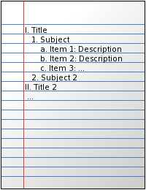
Note-taking methods
Outline Form
Notes:
These methods depend on how you learn and what type of class or lecture it is

Slide 25
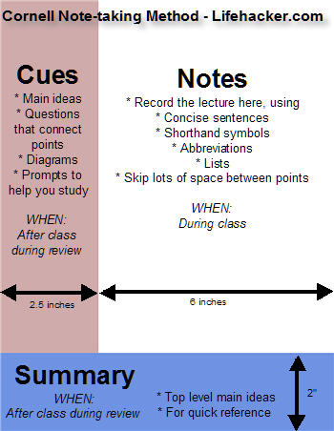
Cornell Note-Taking
  If this method does not necessarily work for the place of the lecture, try using it to study!!!

Slide 26
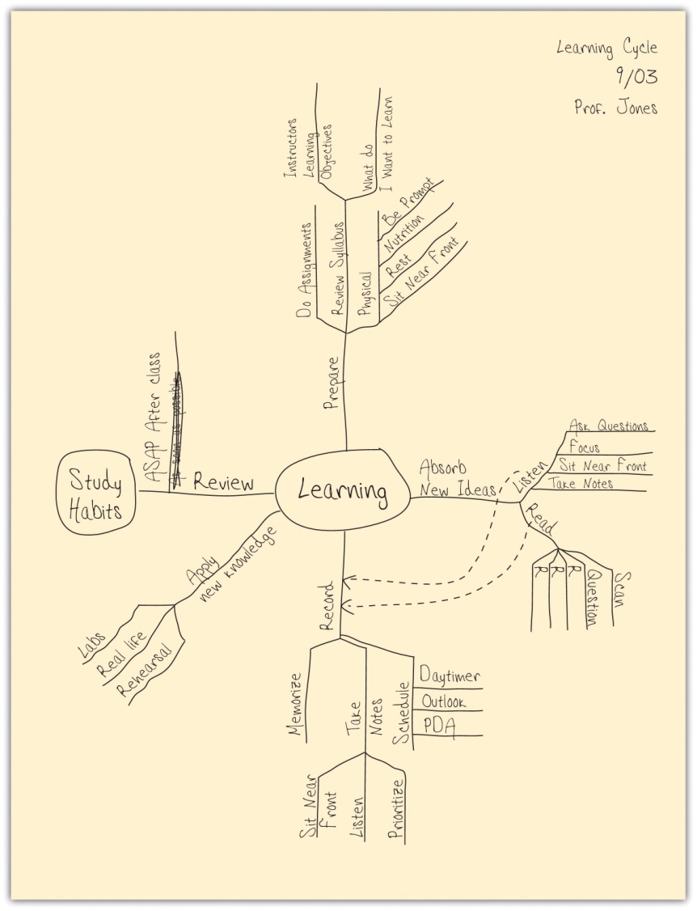
Think Links
Notes:
Think of one concept, which leads to the next, to the next, and so on…
This method is good for history or class discussion

