Slide 1
Managing Test Distractions and Anxiety
University Counseling CenteR
Study Skills Seminar
Memorial Hall, First Floor

Slide 2

University Counseling Center (UCC)
Memorial Hall 102
M, T, W, Th 8:00 a.m.-5:00 p.m.
Friday 8:00 a.m.-4:30 p.m.
(309) 298-2453
www.ucc.wiu.edu

Slide 3
UCC Services
Individual Counseling
Group Counseling
Career Counseling
Academic or learning skills assistance
Outreach Programming
Academic Instruction
Assessments
  Psychological
  Vocational
  Learning Disabilities
  Standardized tests
Consultation
Training of Graduate Students / Interns

Slide 4
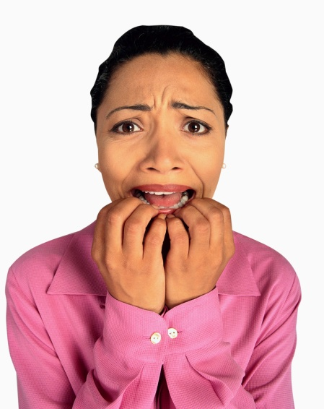
What we will cover today:
What Is Test Anxiety?
Causes of test anxiety
Managing Test Anxiety

Slide 5
WHO FEELS GOOD ABOUT DOING POORLY ON AN EXAM????

Slide 6
What is test anxiety?

Slide 7
Test Anxiety
Test and performance anxieties describe responses specific to evaluative situations—situations in which you are being observed or evaluated by others.
  The primary "threat" in these situations is the possibility of failure and loss of esteem.
  When you believe that you are inadequate or incapable of meeting the challenge
  You fear the consequences of possible failure.
Notes:
Anxiety becomes a reaction to a threat, whether the threat is real or perceived.

Slide 8
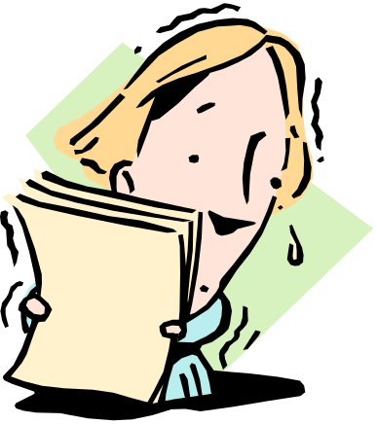
What is Test Anxiety?
Becoming especially nervous and anxious immediately before or during an exam
Common Symptoms
  Shaking
  Trembling
  Increased Heart Rate
  Muscle Tension
  Nausea
  Headaches
  Difficulty Concentrating
  Becoming Easily Distracted
  Lack of Confidence
  Negative Self-Talk
May interfere with test performance
Notes:
May be so wrapped up in your physiological experiences (shaking, sweating, nausea, etc) that you are unable to recall test information or concentrate fully.

Slide 9
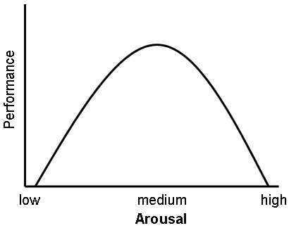
Arousal and Anxiety
Some level of arousal is good
But need to be wary of too much arousal
Can also be a signal that you need to prepare more
Notes:
- People generally perform best when they have a moderate level of arousal
- You need a certain level of arousal to care about what you are doing, stay awake, and be alert
- Want to avoid being too aroused or anxious because this would impair your ability to focus and concentrate in a relaxed fashion
- Appropriate levels can sharpen your reflexes, alertness, and mental processing ability.

Slide 10
So, when does test anxiety turn bad??
As previously stated, test anxiety is not inherently harmful; when positively directed, this increase in energy actually enhances exam performance.
Only when this energy is directed away from positive performance does it become a problem.

Slide 11

Causes of Test Anxiety
Why do some people experience it and some do not?
Notes:
* Student Input

Slide 12
Several Common Sources
Overstating the importance of exams
Previous negative experience with test taking
Fear of disappointing others
Focusing only on outcome, rather than improvement
Having unrealistic performance expectations
Poor preparation
  Poor time management, poor study habits, and lack of organization can lead to a student feeling overwhelmed
Lack of confidence, fear of failure

Slide 13

Managing Test Anxiety

Slide 14

Keep in mind ABCDE
A-Activating event
  Test
B-Belief system
  “I am going to fail.”, “I
  don’t know the material.”
C-Consequence
  Test Anxiety
D-Dispute
  “I am going to pass the test.”, “I am going to do my best.”
E-new Effect
  The test no longer makes you anxious
Notes:
A-in this case, the activating event is the test
B-”I’m going to fail” “I don’t know the material” “It’s too hard for me”
C- the consequence is the test anxiety
D-”I am going to pass the test” “I’m going to get a good grade” “I’m going to do my best”
E-the test no longer makes you anxious, it is what you tell yourself that helps you calm

Slide 15

Prepare!
Better prepared=more confident
Begin review early
Know what will be covered on the test & format
Cramming can raise anxiety
Notes:
Try to lessen the anxiety by being proactive rather than reactive
- Consider making reviewing for exams an ongoing process
- Also find out how many points, and length of exam
- Don’t just sit and worry, put your energy into concrete active steps to help you succeed

Slide 16
Additional Tips and Techniques for
Getting Prepared!!!
Attend all of your classes, and find out what is expected of you so that you know what will be on exams and when exams are scheduled.
Keep up with your work so that you can avoid “cramming” for exams.
Become more efficient in your study habits and time management skills.
Have a study schedule that makes use of any “wasted time.”
Study in a location where you can concentrate, get interested in the material, and give it your complete attention.
Make flashcards and review them often.
Learn how to take good notes, and review them right after class and periodically.
Notes:
Other tips: Be organized and know what is coming

Slide 17
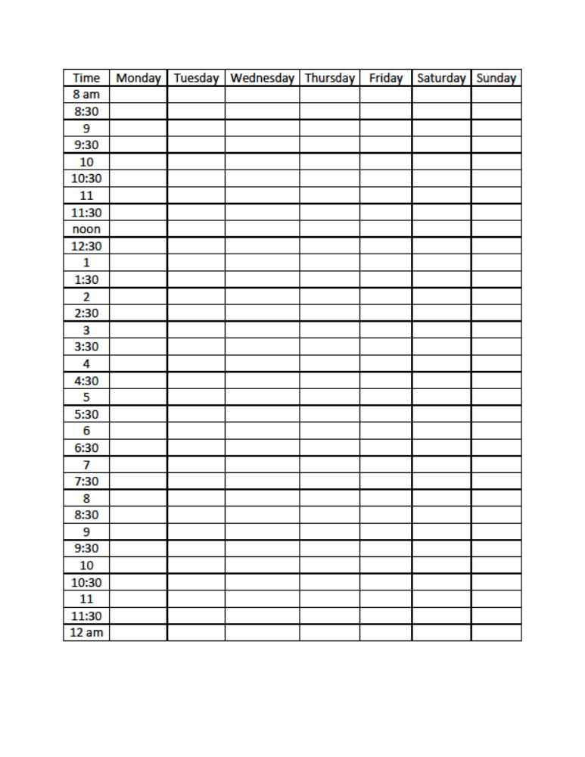

Slide 18
Additional Tips and Techniques for Getting Prepared Cont.
Make outlines and summary sheets.
Ask yourself, “What is the important information?”
Being in a study group with motivated classmates is often helpful.
Take advantage of the Writing Center and the Counseling Center here at WIU to help you improve your study skills, test-taking skills, and writing skills.
Make appointments at the UCC for personalized study skill seminars.
Free tutoring is available. Don’t be afraid to use it!
Aim for A level of understanding. Don’t overprotect yourself by saying you’ll be lucky to get a C, so why study more.
Take care of yourself by eating well and getting enough sleep. Plan time to exercise regularly.
In general, organized, self-confident students with efficient study habits may actually spend less time studying than others who receive lower grades.

Slide 19
Visualization
Mental visualization
Imagine yourself performing a specific activity without any physical movements
Probably find that your levels of stress and physical tension reduce while your confidence and performance levels increase
Notes:
-Visualize yourself being confident and in control, you sit at your desk and look calmly around the room. You write your name on the exam and carefully read the directions before answering the questions correctly.

Slide 20
Establish Your Comfort Zone
Become familiar with testing environment
Try to study in room similar to exam room
Notes:
Get to the room early to become comfortable, esp. if the room is new to you– also get choice of seat then!
- The more similarity there is when you study, the more likely you will perform well when you compete or take your exam
*Read somewhere that chewing gum during lecture and while studying and then chewing the same gum during the test may help you remember

Slide 21

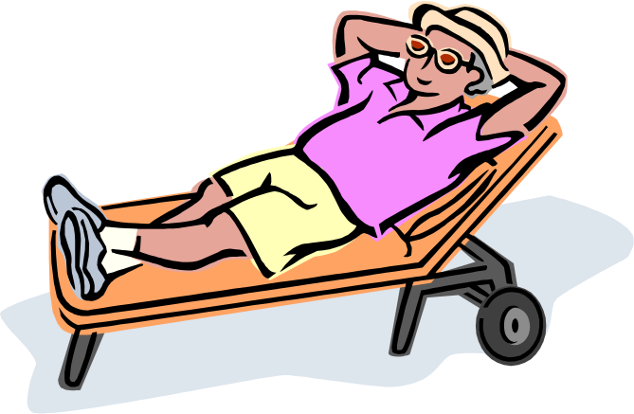
Relaxation
Muscle Relaxation
Deep Breathing
Listen to calming music
Notes:
Recommend the counseling center website-relaxation recordings; www.wiu.edu/ucc → Programs and Services → Relaxation Station → Autogenics, Guided Visualization, Progressive Muscle Relaxation
- Also can do meditation, yoga, etc.
What helps you to relax?

Slide 22
Accentuate the Positive
Control your thoughts
  Focus your thoughts on the test, not on what others are doing
Eliminate negative self-talk
  It may be useful to expect you will not know all the answers
See the test as an opportunity to learn
  Not an opportunity to fail, but an opportunity to see what you have learned
See the test as a signpost
  It’s not a win or lose-rather a signpost along the way to a greater goal
Give instructor a positive role
  Engage your professors in your learning experience
Seek study partners
  Don’t study with others who also have anxiety
Set yourself up for success
  Know you are responsible for outcome-don’t assume failure before you have the chance to try
Notes:
Remind self that you are prepared and that exams are opportunities to show what you know
-focus your thoughts on the test, not on what others are doing around you
-it may be useful to expect that you will not know all the answers on the test
-not an opportunity to fail, but rather an opportunity to see what you have learned
-not a contest to win or lose—rather a signpost along the way to a greater goal, may be more likely to try your best, learn from expereince and move on
-engage your professors by going to office hours and take time to clarify material and issues with them before the test
-don’t study with others who also have anxiety—may make you feel worse
-know that you are ultimately responsible for outcome- don’t see failaure before you have had a chance to try

Slide 23
If you still feel excessive anxiety…
Come to the UCC. We have staff who are trained to assist students with such concerns in a supportive and confidential manner.

Slide 24
Thank You!

