Slide 1
Procrastination & Time Management
University Counseling Center
Study Skills Seminar
Memorial Hall, First Floor

Slide 2

University Counseling Center (UCC)
Memorial Hall 102
Hours:
  M, T, W, Th 8:00 a.m.-5:00 p.m.
  Friday 8:00 a.m.-4:30 p.m.
(309) 298-2453
www.ucc.wiu.edu

Slide 3
UCC services
Individual Counseling
Group Counseling
Career Counseling
Academic or learning skills assistance
Outreach Programming
Academic Instruction
Assessments
  Psychological
  Vocational
  Learning Disabilities
  Standardized tests
Consultation
Training of Graduate Students / Interns

Slide 4
Today we will cover:
Procrastination
Time Management

Slide 5
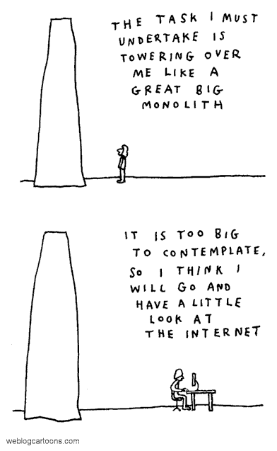
Procrastination

Slide 6
Procrastination
Procrastination is engaging in something other than what you really need to be doing to reach your goals or to accomplish an important task

Slide 7
Procrastination
Not defined by the behavior you are doing at the time, but rather by the purpose of that behavior
Not surprising to hear that students who report higher levels of procrastination, tend to have lower grades
Notes:
For example: If your intent is to delay working on your class project that will highly influence your final grade, then doing your laundry could be procrastination. Even though laundry is an important task in it’s own right!

Slide 8
How do you procrastinate?

Slide 9
Forms of procrastination:
Common behaviors & activities
Watch TV, especially Netflix
Listening to the radio
Talking on the phone
Hanging out with friends
Going to the gym
Surfing the Web—Facebook anyone?
Doing laundry
Writing letters/checking e-mail
Reading magazines/books

Slide 10
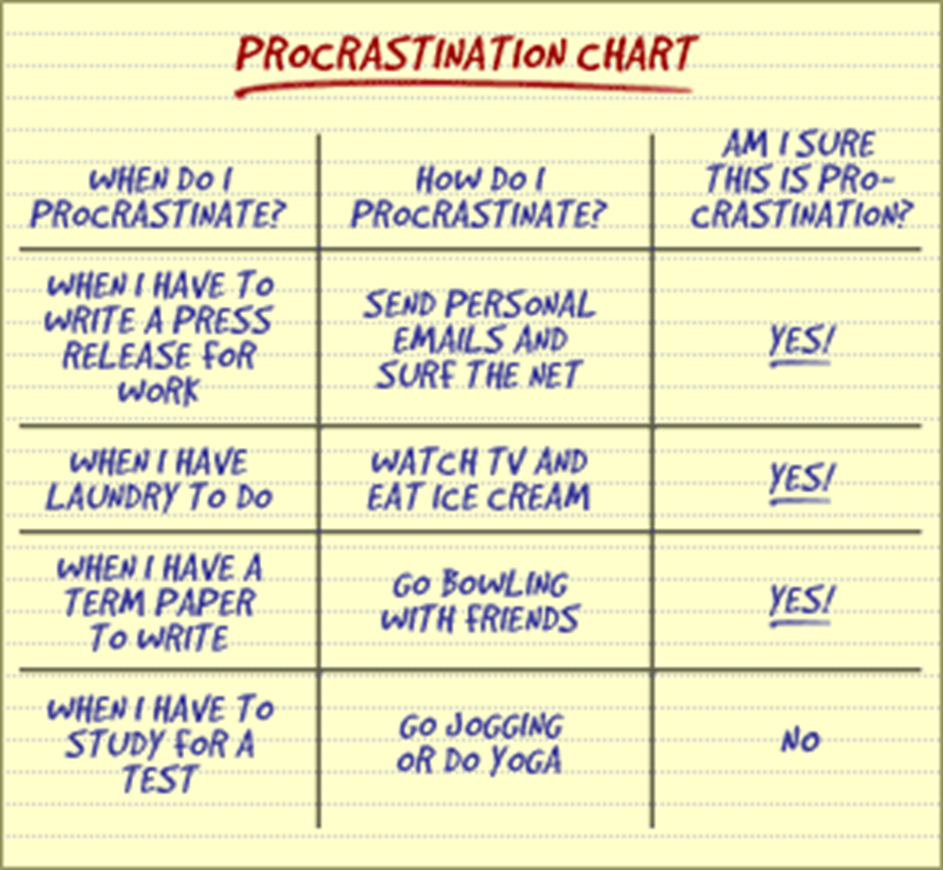

Slide 11
Why do people Procrastinate?
Fear of Failure
Fear of the Unknown
The task is overwhelming
Fear of looking foolish
Notes:
“If I try to take this exam, I am going to do terribly, and I’ll probably get an F”
“I have no idea what the instructor wants for this paper”
“I have a ten-page paper for my English class due next week and 2 exams this week. I don’t know how I am going to find the time to get organized, let alone write and study”
“What if I work really hard on improving my playing skills, but perform poorly in competition?”

Slide 12
Some other common reasons:
Poor time management
Difficulty concentrating
Personal problems
Finding the task boring
Notes:
Not managing time wisely. May be uncertain of priorities, goals, and objectives. May be overwhelemed. Keep putting off academic assignments for a alater date, or spending a great deal of time with your friends and social activities, or worrying about an upcoming exam, class project, and papers rather than completing them
When you sit at your desk you find yourself daydreaming, staring into space, looking at pictures of your boyfriend/girlfriend, etc., instead of doing the task. Your environment is distracting and noisy. You keep running back and forth for equipment such as pencils, erasers, dictionary, etc. Your desk is cluttered and unorganized and sometimes you sit/lay on your bed to study or do your assignments. You probably notice that all of the examples that you have just read promote time wasting and frustration.

Slide 13
Why do you procrastinate??
Need to be honest with yourself and recognize the reasons
Whatever the reason, identify what exactly is interfering with your getting started.

Slide 14
Now that we have some ideas of why we may procrastinate, now we can start thinking about how to overcome this procrastination

Slide 15
Address the Cognitive Distortions
Address the irrational beliefs and cognitive distortions up-front
  Easy to estimate the actual time it takes to complete a task by keeping track of time
  You will be no better motivated in the future than you are right now
Notes:
Ex: If you track that it takes approx. 5 hrs. of study time to get an A or B on a history exam, you can use that information for helping to better schedule your study time on future exams
Common fallacy that leads many people who procrastinate to simply put off doing things into the future when they are in the “right mood”. Ability to be successful @ a task is not dependent upon your mood. Sometimes have to do something we don’t like, even if we don’t feel like, just to get it done. THESE thoughts REINFORCE procrastination thinking.
Start a task for 15 minutes. Once you start, you are more likely to keep going.

Slide 16
Challenge your cognitive distortions
It is not hopeless
It is not too late
You have the ability
You can’t do it later
You will not perform better under pressure
Notes:
Few situations are truly hopeless
There is always time if you start NOW
Or you wouldn’t have made it this far
As you’ll just keep putting “later” off until later
The best work is done when it is well thought out

Slide 17
Organization
Use a planner/appointment book
  Work backwards from the due date
  All tasks can and should be broken down
  Keep track of activities and dates
  Start every day with a review
  Keep track of time relative to your due dates
  Keep it Up-to-date from the start
  Keep a Daily To-Do list
Notes:
Disorganization= Common to many procrastinators!
Can also use phones
While planners are good, also need to commit to changing your behavior (need to remember to write things down in class or at work

Slide 18
Procrastination could be a signal…
That you have taken on too much!
College presents many opportunities to get involved both inside and outside the classroom.
Many professors will offer an extension to a good student who has more things due in a week than is reasonable. (but don’t wait until the last minute)

Slide 19
Procrastination strategies
Realistic goal setting
Plan to work, Plan to play
Self Discipline

Slide 20
Finally. . .
If you need help- get it!
  University Counseling Center
  Get a tutor
  Ask a classmate
Notes:
One on one, speak with her directly about time management and procrastination
Contact academic department for tutor resources, or speak with your advisor
If you know someone in your class who is doing well, ask if they would be willing to help
Organizing study groups may also help motivate you, and help to avoid procrastination!

Slide 21

Time management

Slide 22
Time Management
Time wasters?
  Netflix
  Hanging out with friends
  Playing video games
  Eating/drinking
  Etc.

Slide 23
Benefits for Managing Your Time
Improve academic performance
Time management can help you:
  Stop procrastinating
  Accomplish more during the day
  Have more free time!
  Feel less stressed

Slide 24
Ways to make the best use of your time
(warning: there are 19)
1. Use short and long term schedules
2. Set daily priorities and focus on top-priority items one at a time
3. Do not over-schedule!
4. Plan your day so you are studying when you are most alert and attentive
5. Use 5-10 minute blocks of time you have to complete task or make progress on larger project
6. Use travel time efficiently & productively
Notes:
5. Pay bills, study for an upcoming exam, review notes
6. ex. If you are an aural learner and tape lectures, you could listen to these tapes when you are commuting to school or traveling to games/competitions

Slide 25
Ways to make the best use of your time
7. Make sure notes & study materials are organized & easy to access
8. Begin projects with the intention of completing them
9. Say “no” to requests that interfere with accomplishing your goals
10. Study where you are not likely to get distracted or interrupted
11. Complete low priority tasks when you are least alert and attentive
Notes:
8. If unable to complete the project, make a note as to your progress so you do not have to start from the beginning– so basically just know where you left off
9. i.e. when your friends ask you to go to a party and you still have to finish your poly sci. paper
10. Library?
11. More mindless assignments, or doing laundry while your favorite show is on

Slide 26
Ways to make the best use of your time
12. Videotape your fav. T.V. shows and watch them later when you can skip the commercials
13. Use relaxation and enjoyable activities as rewards
14. Learn to stay focused & attentive so you don’t have to repeat tasks
15. Delegate tasks and responsibilities whenever possible
16. Prepare the night before for the next day
Notes:
12. or watch them online with fewer commercials & more convenient time. Netflix
14. Not having to read the same pages of text over and over again
15. You do not have to do everything– let go of some things
16. Maybe set out your clothes, pack your lunch, get your notebooks/class materials in order– avoid the early morning craziness

Slide 27
Ways to make the best use of your time
17. Run errands efficiently
18. Delegate tasks and responsibilities whenever possible
19. Prepare the night before for the next day
Notes:
17. Do not make multiple or separate trips. Tack errands on other trips that are planned, or try to do as many as possible when on that side of town/campus
18. You do not have to do everything– let go of some things
19. Maybe set out your clothes, pack your lunch, get your notebooks/class materials in order– avoid the early morning craziness

Slide 28
Task Management (To-Do Lists)
Prioritize the tasks you want to complete
  A: Very important task
  B: Somewhat important task
  C: Not very important task
  Remember that priorities can change throughout the week
Be flexible & ask yourself “what is the best use of my time right now?”
Notes:
A’s must be done first
B’s have a little more flexibility
C’s if they get done, good, if not it’s okay

Slide 29
Summary
Procrastination
  Address and challenge your cognitive distortion
  Be organized
  Set realistic goals
Time Management
  Prioritize your time
  Decide what is more important
  Be flexible

