Slide 1
Test Taking/Test Anxiety
University Counseling Center
Study Skills Seminar
Memorial Hall, First Floor

Slide 2

University Counseling Center (UCC)
Memorial Hall 102
Hours:
  Mon.-Thurs.: 8 a.m. to 5:00 p.m.
  Friday: 8:00 a.m. to 4:30 p.m.
(309)298-2453
www.wiu.edu/ucc

Slide 3
UCC Services
Individual Counseling
Group Counseling
Career Counseling
Academic or learning skills assistance
Outreach Programming
Academic Instruction
Assessments
  Psychological
  Vocational
  Learning Disabilities
  Standardized tests
Consultation
Training of Graduate Students / Interns

Slide 4
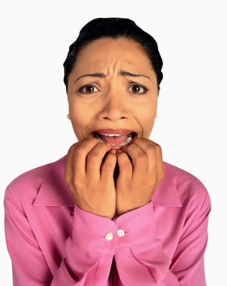
Topics
Test Anxiety
Test Taking

Slide 5
Who feels good about doing poorly on an exam?

Slide 6
What is test anxiety?

Slide 7
Test Anxiety
Test and performance anxieties describe responses specific to evaluative situations—situations in which you are being observed or evaluated by others.
  The primary "threat" in these situations is the possibility of failure and loss of esteem.
  When you believe that you are inadequate or incapable of meeting the challenge
  You fear the consequences of possible failure.
Notes:
Anxiety becomes a reaction to a threat, whether the threat is real or perceived.

Slide 8
What is Test Anxiety?
Becoming especially nervous and anxious immediately before or during an exam
Common Symptoms
  Shaking
  Trembling
  Increased Heart Rate
  Muscle Tension
  Nausea
  Headaches
  Difficulty Concentrating
  Becoming Easily Distracted
  Lack of Confidence
  Negative Self-Talk
May interfere with test performance

Slide 9
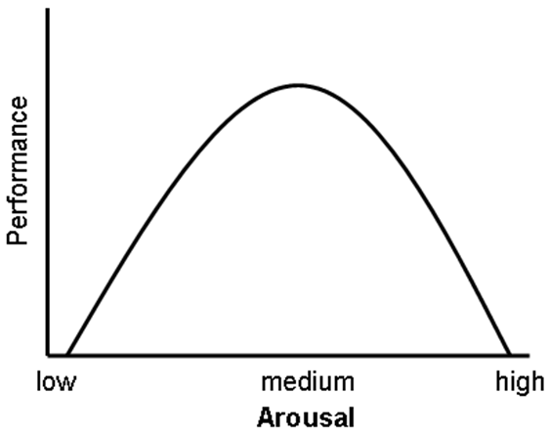
Arousal and Anxiety
May be so wrapped up in your physiological experiences (shaking, sweating, nausea, etc.) that you are unable to recall test information or concentrate fully.
Notes:
- People generally perform best when they have a moderate level of arousal
- You need a certain level of arousal to care about what you are doing, stay awake, and be alert
- Want to avoid being too aroused or anxious because this would impair your ability to focus and concentrate in a relaxed fashion
- Appropriate levels can sharpen your reflexes, alertness, and mental processing ability.

Slide 10
So, when does test anxiety turn bad?
As previously stated, test anxiety is not inherently harmful; when positively directed, this increase in energy actually enhances exam performance.
Only when this energy is directed away from positive performance does it become a problem.

Slide 11
Causes of Test Anxiety
Why do some people experience it and some do not?
Notes:
*Student Input

Slide 12
Several Common Sources
Overstating the importance of exams
Previous negative experience with test taking
Fear of disappointing others
Focusing only on outcome, rather than improvement
Having unrealistic performance expectations
Poor preparation
  Poor time management, poor study habits, and lack of organization can lead to a student feeling overwhelmed
Lack of confidence, fear of failure

Slide 13

Test Taking

Slide 14
Preparing for Success
Notes:
Most important aspect is being prepared
More than just sitting down and reading over your notes and textbooks a day before the exam.
Need to take an active role in finding out what kind of questions will be on exam and what topics will be emphasized

Slide 15

Preparing for Success
Most important aspect is being prepared
  Better prepared = more confident
Find out what will be on the exam, what format it will be in and what topics will be emphasized
Use your syllabus and study guides
Begin reviewing early
CRAMMING CAN RAISE ANXIETY!
Notes:
- Need to take active role in finding out what kind of questions will be on the exam and what topics will be covered
- Often the syllabus will have info on what kind of exam, and professors may provide study guides or specific ideas

Slide 16
Tips and Techniques for Getting Prepared!
Attend all of your classes, and find out what is expected of you so that you know what will be on exams and when exams are scheduled.
Keep up with your work so that you can avoid “cramming” for exams.
Become more efficient in your study habits and time management skills.
Have a study schedule that makes use of any “wasted time.”
Study in a location where you can concentrate, get interested in the material, and give it your complete attention.
Learn how to take good notes, and review them right after class and periodically.

Slide 17
Additional Tips and Techniques for Getting Prepared
Make outlines and summary sheets.
Ask yourself, “What is the important information?”
Take advantage of the Writing Center and the Counseling Center here at WIU to help you improve your study skills, test-taking skills, and writing skills.
Make appointments at the UCC for personalized study skill seminars.
Free tutoring is available. Don’t be afraid to use it!
Aim for A level of understanding. Don’t overprotect yourself by saying you’ll be lucky to get a C, so why study more.
In general, organized, self-confident students with efficient study habits may actually spend less time studying than others who receive lower grades.

Slide 18
Additional Preparations
Mental
  How you approach the test matters!
  Positive and confident
Physical
  Proper rest
  Proper diet
  Be physically comfortable
  Develop consistent routine
  Arrive to test early, but not too early
Notes:
Mental:
The attitude you take toward approaching a task, especially on one that you dread, is a major factor in determining the quality of your performance.
Physical:
Proper rest
If not rested, will have trouble staying mentally alert and focused on the test
Fatigue tends to amplify the symptoms of test anxiety
Proper diet
If hungry, will have difficult time staying focused
Don’t eat too much though either because it may make you sleepy
Physically comfortable
Wear comfortable clothing, Relaxation techniques
Be familiar with the testing environment – try to study in a room similar to the exam room
the more similarity there is when you study, the more likely you will perform well when you compete or take your exam
*Read somewhere that chewing gum during lecture and while studying and then chewing the same gum during the test may help you remember
Arrive early
You determine when to arrive to a test, you may want more review time
Also make sure that you have brought all the necessary materials

Slide 19
Study Techniques
Flashcards
Audiotapes
  Record your notes and write them down
  Also record lecture in case you missed something
Previous Exams
  Help predict what kind of questions to anticipate
  Alert you to the professors style
Study Groups
Notes:
Flashcards
Work well in courses requiring formulas, vocabulary, scientific or technical jargon, and/or short answer
Convenient to study from in between classes or while waiting for the bus (not having to go through a bunch of papers)
Audiotapes
Can also make brief summaries, define concepts, record other information
Previous Exams
May be in library on reserve or the professor may make them available to study from
Instructors have preferred ways of doing things- might emphasize more lecture than book or vice versa
Does instructor focus on examples and detail, main ideas, or themes or a combination
Types of questions
Study Groups
- Has its pros and its cons
Good for high complex material
Bounce ideas, theories, new perspectives, etc. off each other
But! Be cautious because these can be distracting, frustrating (everyone learns at a different pace), and you cannot rely on the group to carry you

Slide 20
Visualization

Slide 21
Visualization
Mental visualization
Imagine yourself performing a specific activity without any physical movements
Probably find that your levels of stress and physical tension reduce while your confidence and performance levels increase
Notes:
Visualize yourself being confident and in control, sit at your desk and look calmly around the room, write your name on the exam and carefully read the directions before answering the questions correctly.

Slide 22
Relaxation

Slide 23
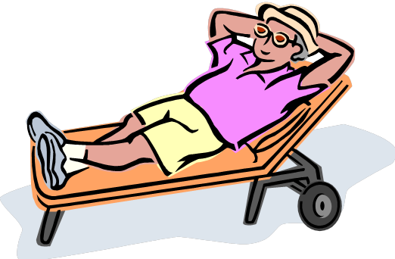
Relaxation
Muscle relaxation
Deep breathing
Listening to calming music
Notes:
Recommend the counseling center website-relaxation recordings; www.wiu.edu/ucc → Programs and Services → Relaxation Station → Autogenic, Guided Visualization, Progressive Muscle Relaxation
Also can do meditation, yoga, etc.
What helps you to relax?
* Student Input

Slide 24
Accentuate the Positive
Control your thoughts
  Focus your thoughts on the test, not on what others are doing
Eliminate negative self-talk
  It may be useful to expect you will not know all the answers
See the test as an opportunity to learn
  Not an opportunity to fail, but an opportunity to see what you have learned
See the test as a signpost
  It’s not a win or lose-rather a signpost along the way to a greater goal
Give instructor a positive role
  Engage your professors in your learning experience
Seek study partners
  Don’t study with others who also have anxiety
Set yourself up for success
  Know you are responsible for outcome-don’t assume failure before you have the chance to try
Notes:
Remind self that you are prepared and that exams are opportunities to show what you know
-focus your thoughts on the test, not on what others are doing around you
-it may be useful to expect that you will not know all the answers on the test
-not an opportunity to fail, but rather an opportunity to see what you have learned
-not a contest to win or lose—rather a signpost along the way to a greater goal, may be more likely to try your best, learn from experience and move on
-engage your professors by going to office hours and take time to clarify material and issues with them before the test
-don’t study with others who also have anxiety—may make you feel worse
-know that you are ultimately responsible for outcome- don’t see failure before you have had a chance to try

Slide 25
Types of Exams

Slide 26
Objective Tests
Multiple choice, true-false, matching, fill-in-the-blank
There is only one correct or best answer
Need to use deep level processing, not just surface level
Notes:
- These tests require thought, analysis, integration, and practical application
Need to use deep level processing:
Deep level approach will let you understand relationships in the information you are learning, and be able to discriminate between answers that are similar
Recognition alone will not help you when the answers look similar

Slide 27
Subjective Tests
Short answer & essay
Recall and organize what you have learned & communicate to instructor
Study for recall
Deep level processing is essential
Notes:
Study for recall:
- Study for recall means learning the material well enough to come up with it on your own when necessary and being able to recognize it in other forms other than the way it was initially presented to you
- Look at material more broadly & require you to focus on concepts, need to learn the material well enough to teach it or explain it to someone else

Slide 28
Take-home and Open-book Tests
Typically subjective
Solve problems, think, discover, and integrate a variety of concepts
Performance expectations generally higher
See how well you can think
Don’t assume you don’t need to study
Notes:
Performance expectations generally higher:
Because of extending time involved on take home exam and because of the access you have to reference material with both formats—higher expectations to do well
See how well you can think
How well you think, rather than how well you recall or recognize information
Need to know where to find info quickly, will still have to be able to integrate info & organize it

Slide 29
Actually Taking the Test
Notes:
For any test, make sure you read the instructions, and fill in name, date etc.
Also, make sure you listen to teacher instructions!! May let you know about an error on the test, or specific way to do something
- Look over entire test to help budget time
- Also may want to wear a watch

Slide 30
Objective Test
Answer ones you are sure of
Try to answer questions before looking at options
Write down anything you may forget
Look for internal clues
T/F: Pay attention to longer sentences or ones with 2 or more statements—everything needs to be true in order to be correct
Notes:
Answer ones you are sure of:
- Will give confidence boost, and ensure that you get those “easy points” without wasting too much time initially on hard questions

Slide 31
Objective Tests
“Always, never, all, or none” are rarely correct
“Generally, often, some or most” are more likely to be correct
Many of these tips are guessing strategies

Slide 32
Subjective Tests
Make sure you understand the question
Plan before you begin
Be brief, but make your point
Include transitions
Watch verb tenses
Reread if you have time
Notes:
Pay special attention to key words in instructions ex. “compare AND contrast”

Slide 33
If you still feel excessive anxiety…
Come to the UCC. We have staff who are trained to assist students with such concerns in a supportive and confidential manner.

Slide 34
Thank you!

